Slide 1
The Triangulum The Future is Now!
UC Smoke and Tobacco Free Fellows Webinar
November 7, 2017

Slide 2
Webinar Series Goal
Familiarize UC Smoke and Tobacco Free Fellows and other Task Force members with the broad contours the current tobacco control and tobacco research landscape

Slide 3
Webinar Series At-A-Glance
September Fellows Orientation
Michael Ong, Julie Chobdee, Phil Gardiner
October Tobacco Polices
Stan Glantz, Kim Vagadori, and Phil Gardiner
November The Triangulum
Phil Gardiner
December Nicotine Pharmacology
Neal Benowitz

Slide 4
Webinar Series At-A-Glance
January Tobacco Health Disparities
Pebbles Fagan
February 2nd and 3rdhand Smoke
Susan Schick
March Cessation
Elisa Tong
April The Tobacco Industry
Pamela Ling

Slide 5
Triangulum Webinar Goal
To familiarize Fellows and task force members with the rapidly changing and diverse “smoking” landscape of the early 21st century

Slide 6
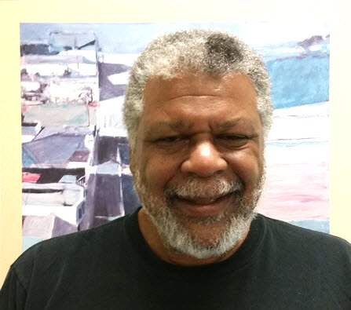
Presenter
Phil Gardiner, Dr. P.H., UC Smoke and Tobacco Free Fellows Program Officer; Tobacco Related Disease Research Program, University of California Office of the President

Slide 7
Ground Rules
The presentation will be approximately 60 minutes
Q&A
Voice
Written
Closing Thoughts and Lessons for next time

Slide 8
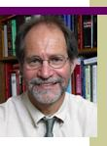
Nicotine Pharmacology and Nicotine Addiction; 12/05/2017
Presenter: Neal Benowitz, MD. UCSF, Center for Tobacco Control Research and Education

